Slide 1
DDI as a Common Format for Export and Import from Statistical Packages
Larry Hoyle
Institute for Policy & Social Research, University of Kansas
&
Joachim Wackerow
GESIS - Leibniz Institute for the Social Sciences

Slide 2
DDI - Moving Data across Space and Time
Across space – one organization to another
Across time – via an archive
Across software
Different organizations use different software
Software, and preferences for software evolve over time
Optimize for clarity and completeness, not necessarily for speed/efficiency

Slide 3
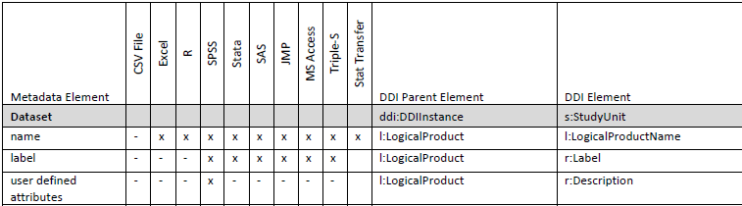
DDI 3.1 as Common Format
Dagstuhl 2009 paper (Hoyle, Wackerow & Hopt)
Metadata elements in software packages and DDI
Oops – Stata command can make a characteristic on a dataset:
"Define characteristic one attached to the data
. char _dta[one] this is char named one of _dta"

Slide 4
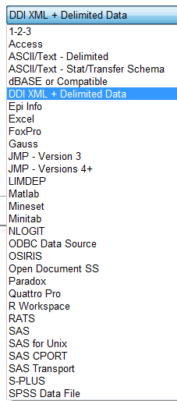
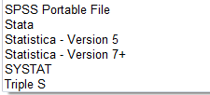
Stat/Transfer (http://www.stattransfer.com/)
Data conversion software
Added DDI 3.1 with version 11
DDI plus 35 other file formats
Metadata aware
This paper not intended as a critique of Stat/Transfer. Any suggestions for changes are offered with the intent of improving a very useful tool.
Notes:
Stat/Transfer is software focused on moving data "Between Worksheets, Databases & Statistical Packages" . DDI is a metadata structure. The intent of DDI 3.1 is to provide a structure for organizing and containing metadata across the whole data lifecycle.

Slide 5
Our Experiment With Stat/Transfer (S/T) Questions
What is currently automatic in moving data and metadata among software packages through DDI?
(no scripts needed)
What else does DDI support that S/T does not ?
What more could DDI support?

Slide 6
Our Experiment With Stat/Transfer
R
SPSS
Stata
DDI
SAS
JMP

Slide 7
Our Experiment With Stat/Transfer
R
R
SPSS
SPSS
Stata
DDI
Stata
SAS
SAS
JMP
JMP

Slide 8
Our Experiment With Stat/Transfer
Create master DDI 3.1 file and associated data file
Export to R, SPSS, Stata, SAS, JMP
What metadata features carry over?
Create a dataset in each package, convert to DDI3.1
Include all identified metadata features for that package
Example: a characteristic named "Universe" if supported
Check which metadata features are included
Build matrices showing which metadata would survive transition from one package to the other with DDI as an intermediary

Slide 9
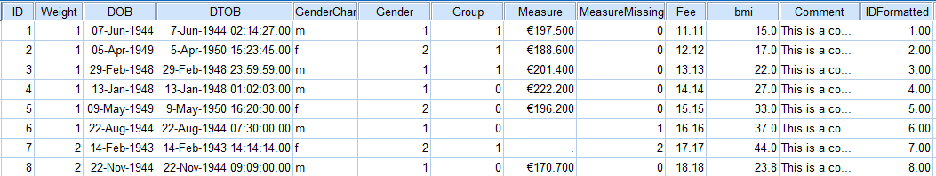
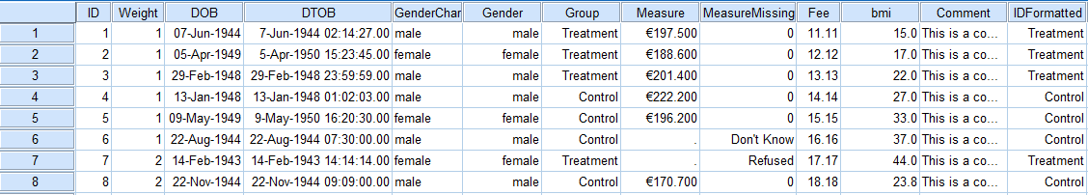
The Dataset
Without labels
With labels

Slide 10
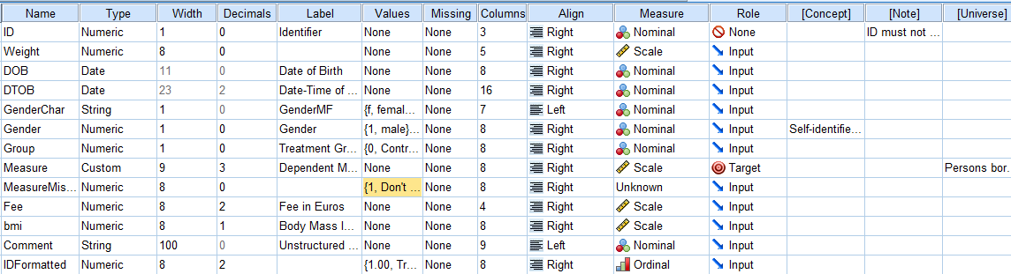
Custom Attributes (e.g. in SPSS)

Slide 11
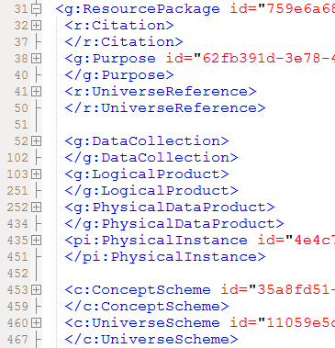
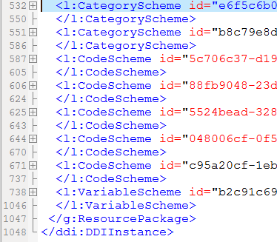
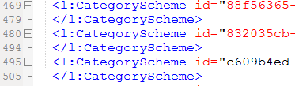
ResourcePackage vs StudyUnit?
Stat/Transfer uses ResourcePackage

Slide 12
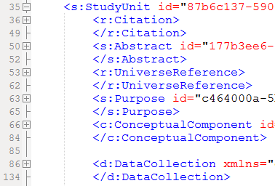
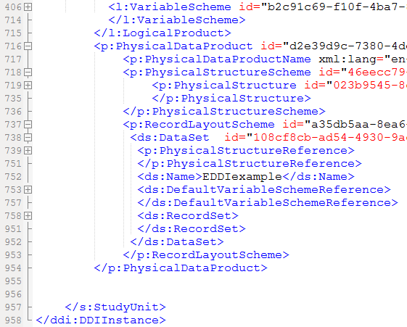
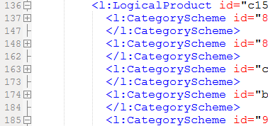
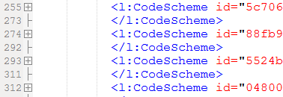
StudyUnit
Currently does not appear to work with Stat/Transfer

Slide 13
Embedded Data
Currently No Option with Stat/Transfer
Missed opportunity?

Slide 14
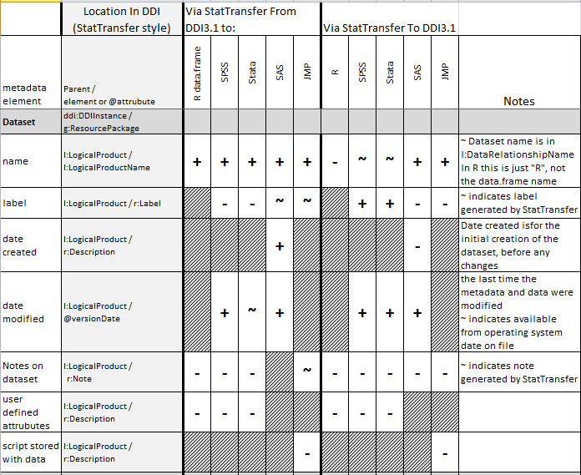
One Output: A Grid of Success/Failure
Indicates feature not supported in package
+ Feature translated successfully
- Feature didn't translate
~ Partial success
e.g. there, but in an unexpected element

Slide 15
What Generally Worked (Classic Codebook)
Dataset Name
Variable Names, Labels, Order
Data type (e.g. Dates and DateTimes ok)
Missing or not
Data
i.e. Elements supported by all of the packages

Slide 16
What Mostly Worked
Dataset Labels
Date Modified
Value Labels for Numerics <–> Categories and Codes
R is different (factors)
SAS formats should work soon

Slide 17
Problems, Dataset
Notes
User defined attributes
Scripts

Slide 18
Dataset Level

Slide 19
Problems - Variables
Weight (pretty important)
Display formats (no standards across packages)
Measurement units (important , most don't support)
Measurement level
Number of decimal positions
Scale (where supported)
Role
User defined attributes (could be useful)
Notes

Slide 20
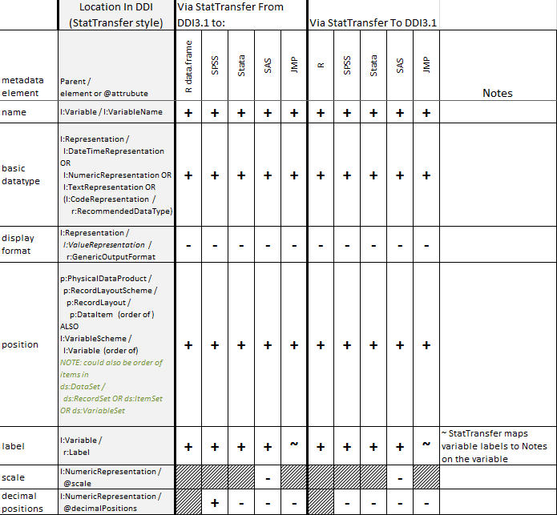
Variables
No standards
Not universally supported by packages

Slide 21
Problems - Values
Multiple distinct missing
Ranges labeled
Multiple sets of labels for a variable
Range restrictions
Labeling text values (will be fixed)
Colors (only for JMP)

Slide 22
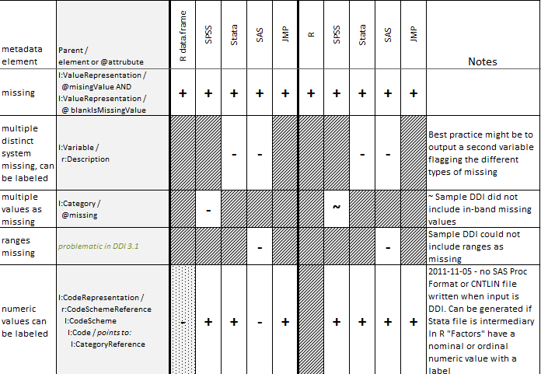
Values

Slide 23
Multiple Missing Values
Multiple Distinct
In-band (SPSS) 998, 999
vs
distinct system missing (SAS, Stata) .D, .R
No representation in DDI
No way to associate categories & codes
vs
No distinction among missing types (R,JMP)

Slide 24
Multiple Sets of Value Labels for a Variable
SAS – "formats" and "informats" stored separately in a catalog or "CNTLIN" dataset.
proc format cntlout=eddi.sas_Fmts;
value GENDERen
1="Male" 2="Female";
value GENDERde
1="Männlich" 2="Weiblich";
value GenderL
1="Self Identified Male" 2="Self Identified Female";
…
format gender GENDERen.;

Slide 25
Multiple Sets of Value Labels for a Variable
Stata- Script
label define GenderE 1 "Male" 2 "Female"
label define GenderG 1 "Männlich" 2 "Weiblich"
label values Gender GenderE
Stata – unassociated value labels not saved to .dta file, but are saved to "dta" xml file.
<value_labels>
<vallab name='GenderG'>
<label value='1'>Männlich</label>
<label value='2'>Weiblich</label>
</vallab>
<vallab name='GenderE'>
<label value='1'>Male</label>
<label value='2'>Female</label>
</vallab>

Slide 26
DDI – Multiple Labels for a Category
DDI – xml:lang and type attributes of Label in Category
<l:Category id=“c1" version="1.0.0" versionDate="2011-10-26T13:33:00" missing="false" >
<r:Label xml:lang="en-US" type="GENDER" >male</r:Label>
<r:Label xml:lang="de" type="GENDER" >männlich</r:Label> <r:Label xml:lang="en-US" type="GENDERL" >Self Identified Male</r:Label>
Which is the "default?" (first listed?)

Slide 27
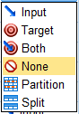
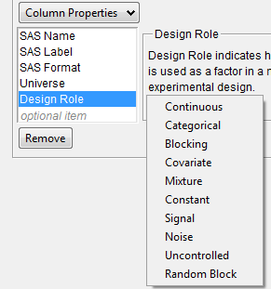
Role
Several packages have metadata for "role"
No standards
SPSS
JMP

Slide 28
Custom/User Variable Attributes
R – attributes
function - attr() (column and data.frame)
Stata – "Characteristics"
function – char (variable or table)
SPSS
VARIABLE ATTRIBUTE VARIABLES=Age Gender Region ATTRIBUTE=DemographicVars ('1').
Jmp
Column Properties … Other

Slide 29
Labeled Ranges in SAS and JMP
Can be used dynamically in analyses, output.
Probably not the best practice for a preservation dataset

Slide 30
Built-in Display Formats
Currency symbols
Thousands separators, decimal separator
Date/Time formats
Some of these (like currency symbols) convey units of measurement)
Again – not standardized

Slide 31
R DateTime and UTC conversion
Conversion may alter DateTime values if assumptions differ about local vs Coordinated Universal Time (UTC).

Slide 32
Using the Grid From Here to There

Slide 33
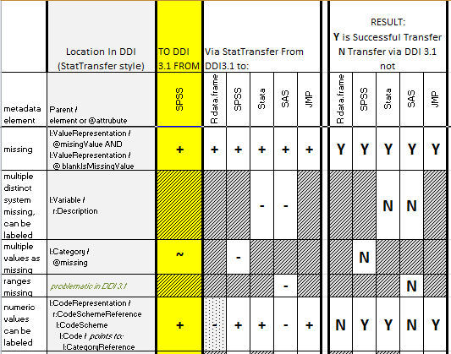
Here to There (and Back Again?)
"Missing" transfers to all packages.
R does not support value labels in the same way as other packages
Fix for importing formats to SAS is pending

Slide 34
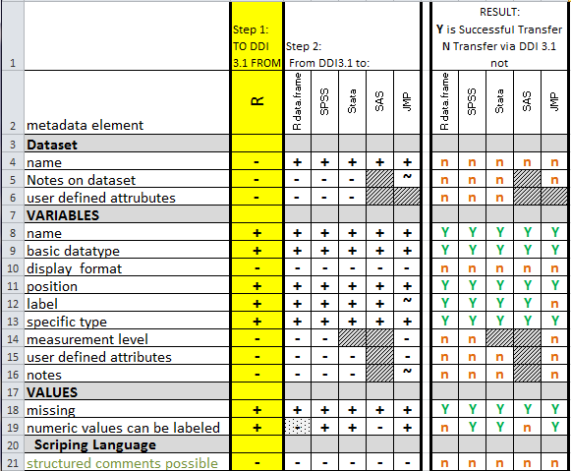
R to the Others
Looking at Just what R contains:
The basics are preserved

Slide 35
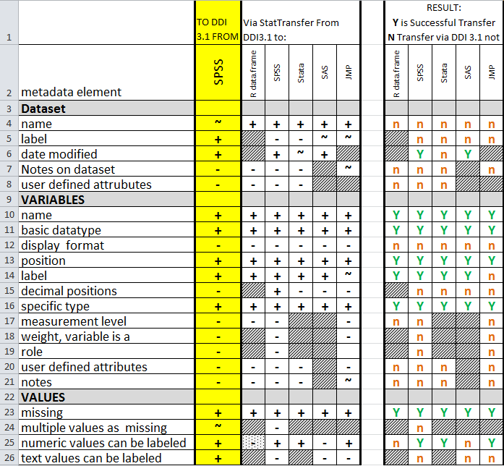
SPSS to the Others

Slide 36
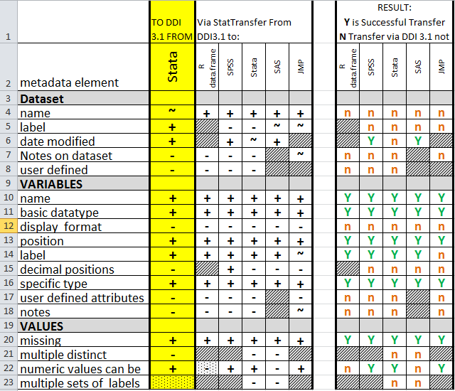
Stata to the Others

Slide 37
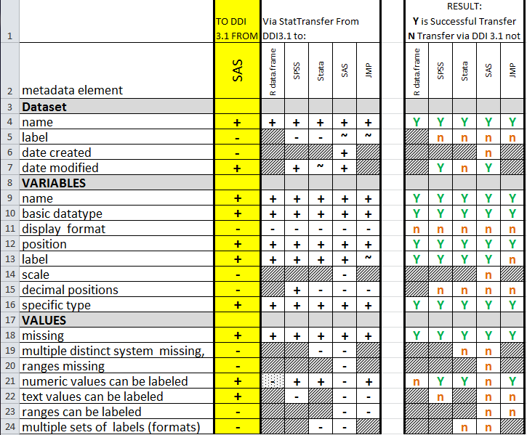
SAS to the Others

Slide 38
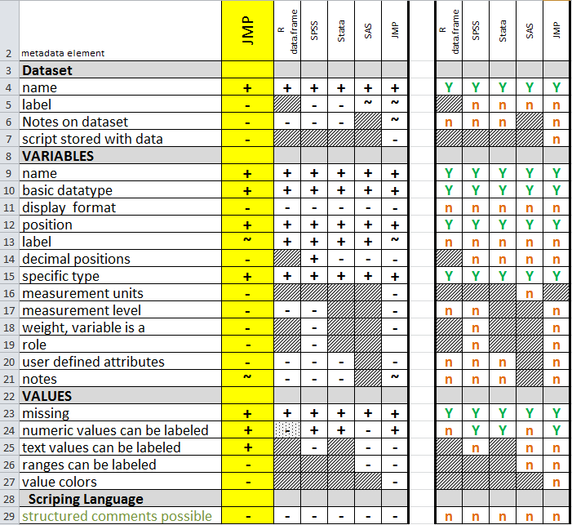
JMP to the Others

Slide 39
Suggestions for DDI – Custom/User Attributes
Named attributes for variables?
<l:Variable>
<l:VariableAttribute>
<r:Name>
<l:Value>
Named attributes for dataset?

Slide 40
Suggestions for DDI - Ranges
Should CodeScheme include a CodeRange element (contains Range and Value, plus CodeRange and Code for hierarchies)?
Alternatively Code could contain a range – this would not be genericode compliant, not such a good idea

Slide 41
Suggestions for DDI – Multiple Labels
<l:Category id="Gm" version="1.0.0" versionDate="2011-10-26T13:33:00" missing="false">
<r:Label xml:lang="sv" type="GENDERshort">kvinna</r:Label>
<r:Label xml:lang="de" type="GENDERshort">weiblich</r:Label>
<r:Label xml:lang="en-US" type="GENDERshort">female</r:Label>
<r:Label xml:lang="en-US" type="GENDERLong">Self Identified Female</r:Label>
</l:Category>
Which "type" was the primary/default/selected (if any)?

Slide 42
Suggestions for DDI – Multiple Labels
<r:Label xml:lang="en-US" type="GENDERshort">female</r:Label>
</l:Category>
Could l:Representation for l:Variable contain "PrimaryLabelType"?
<l:Representation>
<l:CodeRepresentation blankIsMissingValue="true" classificationLevel="Nominal">
<r:RecommendedDataType>string</r:RecommendedDataType>
<l: PrimaryLabelType > GENDERshort </l: PrimaryLabelType >
<r:CodeSchemeReference>
<r:ID>5c706c37-d19b-4b8e-ac6d-40094024421f</r:ID>
<r:IdentifyingAgency>example.org</r:IdentifyingAgency>
<r:Version>1</r:Version>
</r:CodeSchemeReference>
</l:CodeRepresentation>
</l:Representation>

Slide 43
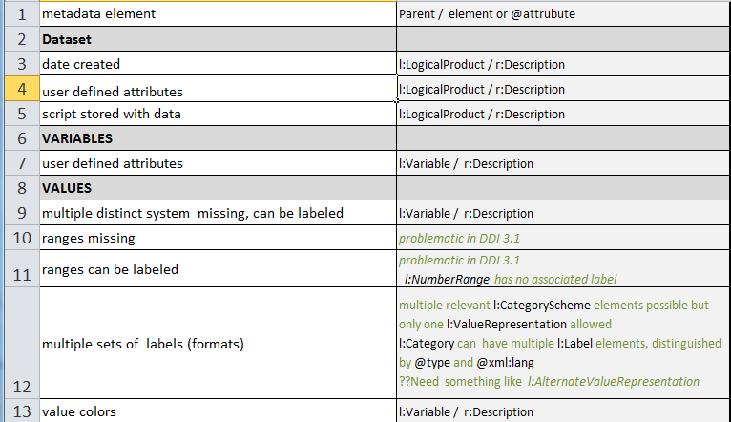
Could be More Machine Actionable Than Using r:Description

Slide 44
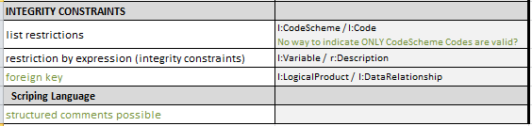
Could be More Machine Actionable

Slide 45
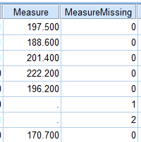
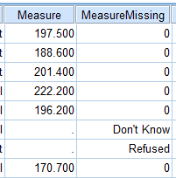
Suggestions for Archival Datasets
Use auxiliary variables to indicate reason for missing
These variables could be shared in a ResourcePackage
Codes
Categories

Slide 46
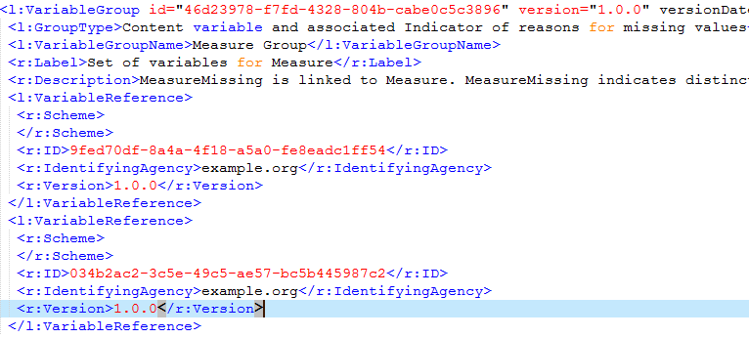
Suggestions for Archival Datasets
Auxiliary Variable for Missing:
Pairing Indicated With Variable Group

Slide 47
Suggestions for Archival Datasets
Create additional variables for alternative formats?
Long labels
Languages
An alternative would be to put multiple labels in keyed relational tables, but having multiple tables creates its own set of complications

Slide 48
Suggestions for Archival Datasets
Create additional variables for coded ranges
Information is lost – depends on what values are present.

Slide 49
Suggestions for Archival Datasets
Use controlled vocabulary for user attributes (characteristics, properties)
DDI based?
Useful for Semantic Data form of DDI element names ?

Slide 50
Conclusions
Adoption of DDI by tools like Stat/Transfer is encouraging.
The current state still means that some important metadata that might be contained in proprietary format data files still must be either
hand entered into DDI or
harvested and entered by user-written or other code.

Slide 51
Conclusions
Basic metadata is transferrable among all 5 packages through DDI
No one package has a superset of the others, several desirable metadata elements are not universally supported
DDI almost supports a superset of the packages considered – a worthwhile goal
Representation as a ResourcePackage vs a StudyUnit can require intermediate transformation
Need best practice recommentation?

Slide 52
References
Hoyle, Larry and Joachim Wackerow with Oliver Hopt DDI 3: Extracting Metadata from the Data Analysis Workflow. DDI Working Paper Series, Schloss Dagstuhl, Germany, 2010. http://dx.doi.org/10.3886/DDIUseCases04
R Development Core Team (2009). R: A language and environment for statistical computing. R Foundation for Statistical Computing, Vienna, Austria. ISBN 3-900051-07-0, URL http://www.R-project.org.
Wright, Philip A. Eliminating Redundant Custom Formats SAS Global Forum 2011 paper 217-2011 http://support.sas.com/resources/papers/proceedings11/217-2011.pdf
JMP - http://www.jmp.com/
R - http://www.r-project.org/
SAS - http://www.sas.com/
SPSS - http://www-01.ibm.com/software/analytics/spss/
Stata - http://www.stata.com/
Stat/Transfer - http://www.stattransfer.com/

Slide 53
Discussion?

Slide 54
Metadata
Shoe reference
http://www.shoecomics.com/archives/shoe_daily/shoe_daily100211.jpg

Slide 55
Contact
Larry Hoyle
University of Kansas,
Institute for Policy & Social Research
LarryHoyle@ku.edu
For files from this presentation see:
http://www.ipsr.ku.edu/ksdata/DDI/

Slide 56
Acknowledgements
The authors view the inclusion of DDI into Stat/Transfer as an important development and look forward to its development into a very useful tool for the DDI community.
Dmitry Basko and Steven Dubnoff at Circle Systems have been very responsive in improving import and export between DDI and Stat/Transfer as suggestions have been made during the development of this paper.

